Slide 1

Wireless
and
Mobile Networks

Slide 2
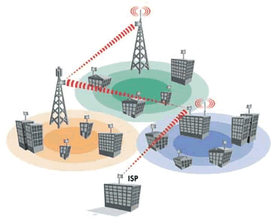

Slide 3
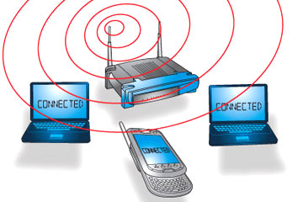

Slide 4
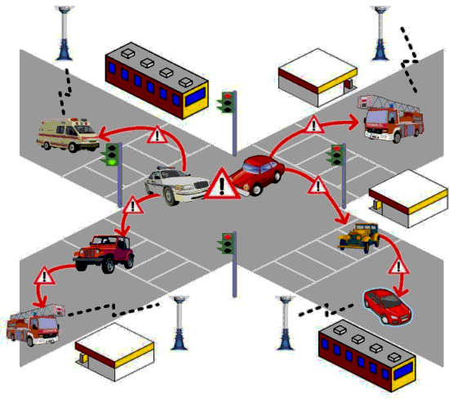

Slide 5
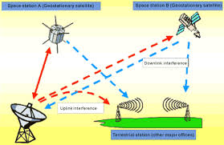
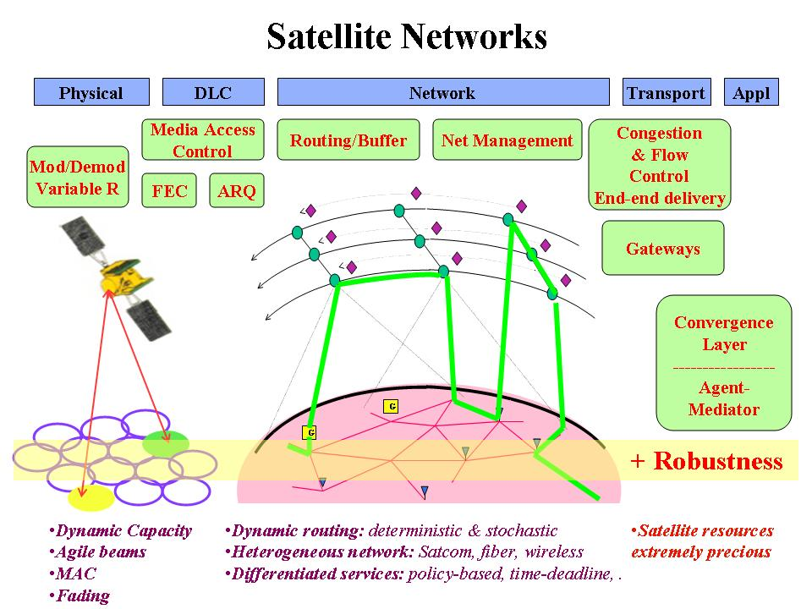

Slide 6
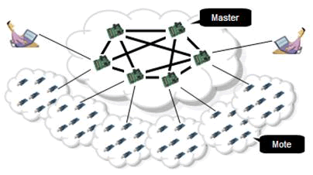
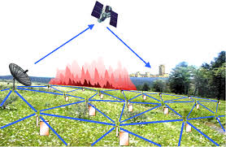

Slide 8
Wireless and Mobile Networks
Background:
# wireless (mobile) phone subscribers now exceeds # wired phone subscribers (5-to-1)!
# wireless Internet-connected devices equals # wireline Internet-connected devices
  laptops, Internet-enabled phones promise anytime untethered Internet access
two important (but different) challenges
  wireless: communication over wireless link
  mobility: handling the mobile user who changes point of attachment to network
Wireless, Mobile Networks
6-<number>

Slide 9



















Elements of a wireless network
Backbone
network
infrastructure
Wireless, Mobile Networks
6-<number>

Slide 10



Elements of a wireless network
wireless hosts
laptop, smartphone
run applications
may be stationary (non-mobile) or mobile
  wireless does not always mean mobility
Backbone
network
infrastructure
Wireless, Mobile Networks
6-<number>

Slide 11

Elements of a wireless network
base station
typically connected to wired network
relay - responsible for sending packets between wired network and wireless host(s) in its “area”
  e.g., cell towers, 802.11 access points
Backbone
network
infrastructure
Wireless, Mobile Networks
6-<number>

Slide 12
Elements of a wireless network
wireless link
typically used to connect mobile(s) to base station
also used as backbone link
multiple access protocol coordinates link access
various data rates, transmission distance
network
infrastructure
Wireless, Mobile Networks
6-<number>

Slide 13
Carrier signal- “the vehicle” to carry data
Every wireless equipment sends data ( voice /text/image/video ) through electro-magnetic signals on the free space medium.
Basic data ( 1s and 0s ) originated by Computer or phone modulates an electro-magnetic signal called Carrier
Wireless, Mobile Networks
6-<number>

Slide 14
Frequency of carrier signal is an important attribute of wireless communication.
Frequency Spectrum is the popular taxonomy
Wireless, Mobile Networks
6-<number>

Slide 15
Since wireless medium can be used by anybody easily, carrier frequencies are regulated by the regulatory bodies like FCC (?) globally,
WPC ( Wireless Planning Commission ) in India.
Wireless, Mobile Networks
6-<number>

Slide 16
What is the meaning of frequency spectrum?
Wireless, Mobile Networks
6-<number>

Slide 17
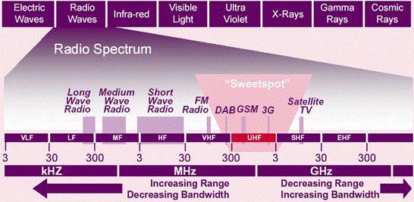
Wireless, Mobile Networks
6-<number>

Slide 18
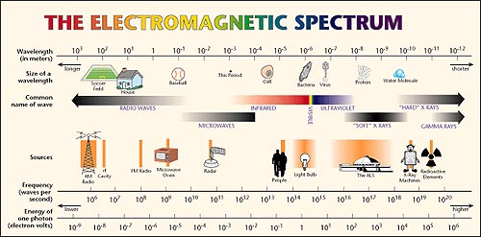
Wireless, Mobile Networks
6-<number>

Slide 19

7.<number>

Slide 20
Characteristics of selected wireless links
200
802.11n
54
802.11a,g
802.11a,g point-to-point
5-11
802.11b
4G: LTWE WIMAX
4
3G: UMTS/WCDMA-HSPDA, CDMA2000-1xEVDO
Data rate (Mbps)
1
802.15
.384
2.5G: UMTS/WCDMA, CDMA2000
.056
2G: IS-95, CDMA, GSM
Indoor
10-30m
Outdoor
50-200m
Mid-range
outdoor
200m – 4 Km
Long-range
outdoor
5Km – 20 Km
Wireless, Mobile Networks
6-<number>

Slide 21
Two modes in Wireless Networks
1. Infra-structure mode
2. Ad-hoc mode

Slide 22
infrastructure mode
base station connects mobiles into wired network
handoff: mobile changes base station providing connection into wired network
network
infrastructure
Wireless, Mobile Networks
6-<number>

Slide 23


ad hoc mode
no base stations
nodes can only transmit to other nodes within link coverage
nodes organize themselves into a network: route among themselves
Wireless, Mobile Networks
6-<number>

Slide 24
Single hop and Multiple hops
single hop
multiple hops
host connects to
base station (WiFi,
WiMAX, cellular)
which connects to
larger Internet
host may have to
relay through several
wireless nodes to
connect to larger
Internet: mesh net
infrastructure
(e.g., APs)
no base station, no
connection to larger
Internet. May have to
relay to reach other
a given wireless node
MANET, VANET
no
infrastructure
no base station, no
connection to larger
Internet (Bluetooth,
ad hoc nets)
Wireless, Mobile Networks
6-<number>

Slide 25
Characteristics of wireless links
As the frequency increases, need of ‘line-of-sight’ increases
Higher frequency links facilitate more ‘bandwidth’
    which means higher data rate
    provision for multiple types of info ( Voice, data, video )
ISM ( Industrial Scientific & Medical band ) is made license free, in most of countries in India
  2.4 GHz
  5.7 GHz
7.<number>

Slide 26
Note on wireless medium…..
Range supported by a wireless link / network is decided by key factors like :
  Transmitted power
  Receiver sensitivity
  modulation technology
  transmission technology
  terrain conditions
    obstruction factors
    attenuation
    weather conditions
Range supported is inversely proportional to the frequency of operation
7.<number>

Slide 27
Wireless Link Characteristics (1)
important differences from wired link ….
  decreased signal strength: radio signal attenuates as it propagates through matter (path loss)
  interference from other sources: standardized wireless network frequencies (e.g., 2.4 GHz) shared by other devices (e.g., phone); devices (motors) interfere as well
  multipath propagation: radio signal reflects off objects ground, arriving ad destination at slightly different times
…. make communication across (even a point to point) wireless link much more “difficult”
Wireless, Mobile Networks
6-<number>

Slide 28
Wireless Link Characteristics (2)
SNR: signal-to-noise ratio
  larger SNR – easier to extract signal from noise (a “good thing”)
SNR versus BER tradeoffs
  given physical layer: increase power -> increase SNR->decrease BER
  given SNR: choose physical layer that meets BER requirement, giving highest thruput
    SNR may change with mobility: dynamically adapt physical layer (modulation technique, rate)
10⁻¹
10⁻²
10⁻³
BER
10⁻⁴
10⁻⁵
10⁻⁶
10⁻⁷
10
20
30
40
SNR(dB)
QAM256 (8 Mbps)
QAM16 (4 Mbps)
BPSK (1 Mbps)
Wireless, Mobile Networks
6-<number>

Slide 29

Wireless network characteristics
Multiple wireless senders and receivers create additional problems (beyond multiple access):
A
B
C
C
A’s signal
strength
C’s signal
strength
B
A
Hidden terminal problem
B, A hear each other
B, C hear each other
A, C can not hear each other,
means A, C unaware of their interference at B
space
Signal attenuation:
B, A hear each other
B, C hear each other
A, C can not hear each other interfering at B
Wireless, Mobile Networks
6-<number>

